Slide 1
Predicting Salaries Using Machine Learning
By: Jennifer Ma
Aug 2020

Slide 2
Outline
Defining the Goal
Methodology
Results: EDA
Results: Machine Learning Models
Conclusions

Slide 3
Defining the Goal
The goal of this project is to examine a dataset containing job postings and to predict the salaries for a new set of job postings
This involves exploring & cleaning the data followed by building a model to predict salaries and using mean squared error as a key metric for accuracy.

Slide 4
Business Impact
Employees are an important resource for a company
Recruitment of good employees is challenging. Offering the right compensation can help attract the right candidate.
Finding the right candidate quickly will reduce time and money spent on recruitment
Notes:
https://risepeople.com/blog/employee-retention-factors/

Slide 5
Dataset Information
The dataset contains 7 features, plus salary (target feature) and job ID (unique identifier)
Numerical Features
Salary (target feature)
Years of experience
Miles from metropolis
Categorical Features
Job ID (unique identifier)
Company ID (36)
Job type (8)
Degree (5)
Major (9)
Industry (7)

Slide 6
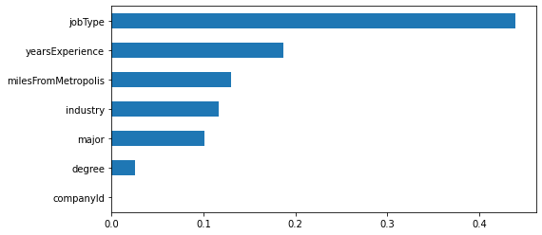
Key Takeaways
The relationship between salary and seven features was examined using three machine learning algorithms:
Classifier | Ave MSE
Linear Regression (baseline) | 384
Linear Regression + PCA | 384
Random Forest Regressor | 374
Gradient Boosting Regressor | 357

Slide 7
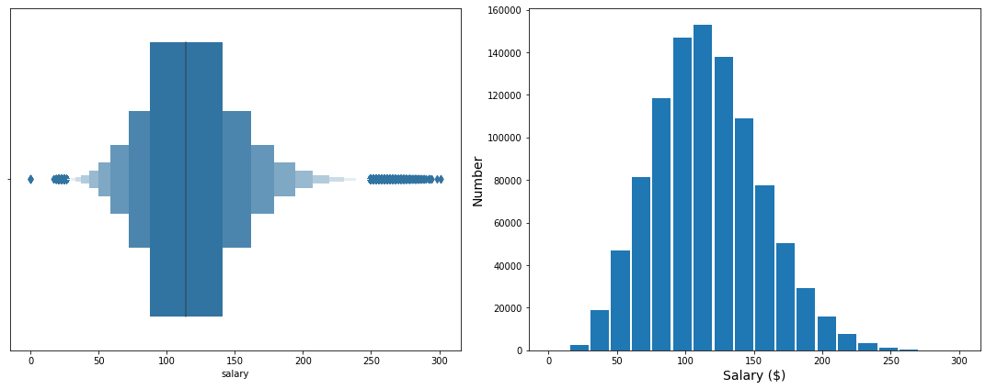
Exploratory Data Analysis
The train_salaries dataset contained 1 millions records, each with a unique jobId identifier and the target feature “Salary”
No duplicate values and 5 invalid data points were removed

Slide 8
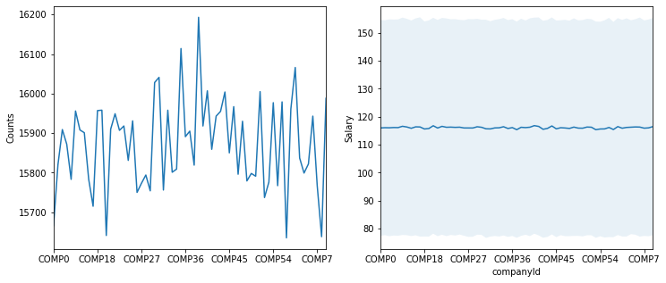
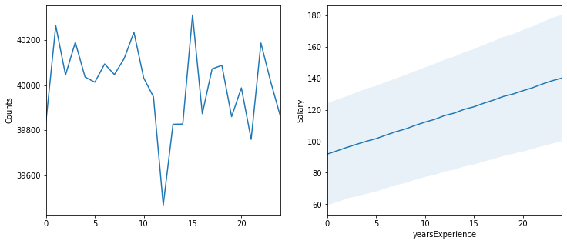
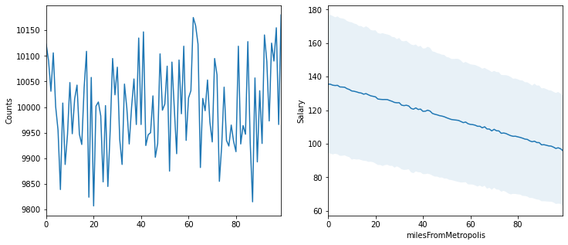
Exploratory Data Analysis
--------------------- COMPANY ID ---------------------
The train_features dataset contained 1 million records, each with a unique jobId identifier and 7 features
---------------YEARS OF EXPERIENCE ---------------
------------- MILES FROM METROPOLIS -------------

Slide 9
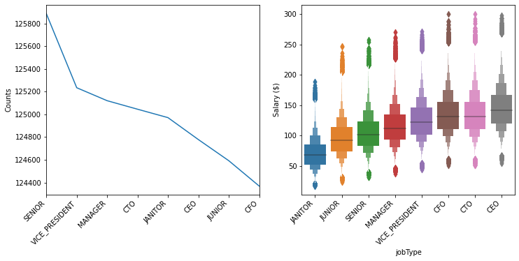
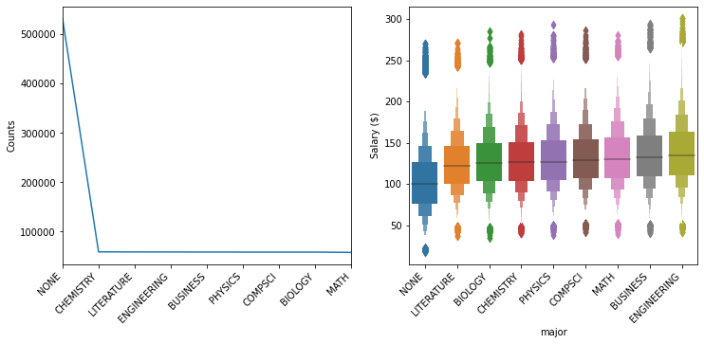
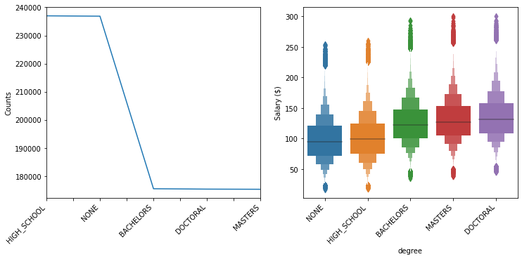
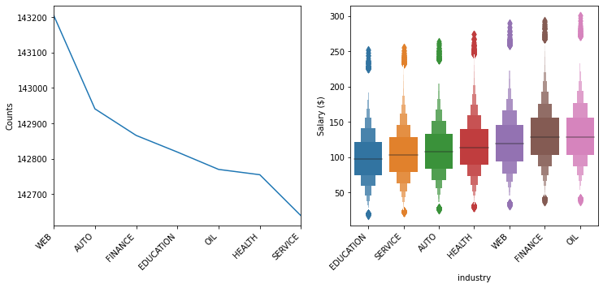
Exploratory Data Analysis
---------------------JOB TYPE ---------------------
--------------------- MAJOR ---------------------
--------------------- DEGREE ---------------------
--------------------- INDUSTRY ---------------------

Slide 10
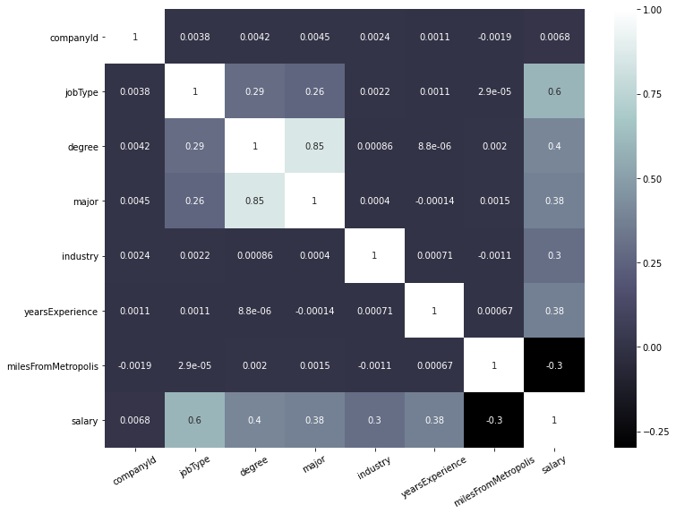
Exploratory Data Analysis
Correlation matrix indicates:
Categorical features were encoded using average salary for each category
Job type is the most highly correlated with salary
Degree and Major are highly correlated

Slide 11
Modeling
Three classifiers were tested, using mean square error (MSE) as the key evaluation metric for accuracy.
The Gradient Boosting Regressor model resulted in the lowest MSE.
Classifier | Ave MSE
Linear Regression (baseline) | 384
Linear Regression + PCA | 384
Random Forest Regressor | 374
Gradient Boosting Regressor | 357

Slide 12
Modeling
Classifier | Ave MSE
Linear Regression (baseline) | 384
Linear Regression + PCA | 384
Random Forest Regressor | 374
Gradient Boosting Regressor | 357
Salaries for new job postings (test data) were predicted using the Gradient Boosting Regression model and saved as a .csv file

Slide 13
Model Improvements
Feature engineering of years of experience and miles from metropolis
Company ID did not contribute to the model development. It can be removed for future modeling.
Further refinement of model parameters

Slide 14
Gradient Boosting Regression
Gradient boosting is a supervised learning technique, which produces a prediction model as an ensemble of weak prediction models
Weak models are models that consistently beat random guessing, such as a decision tree
Ensemble method is a combination of many weak prediction models
Boosting improves overall model performance by focusing on reducing error

